Slide 1

Chapter 1
Introduction to web development
Notes:
Session: Ghi số thứ tự session trong môn học
Session Name: ghi tên của session sẽ dạy

Slide 2
Objectives
How web application work
The components of a JavaScript application
How to test a JavaScript application
How to develop a JavaScript application
Notes:
Mô tả nội dung mà học viên phải đạt được khi kết thúc môn học này

Slide 3
How web application work?
Notes:
Session: Ghi số thứ tự session trong môn học
Session Name: ghi tên của session sẽ dạy

Slide 4
Definitions
World Wide Web (Web)
WWW consist of all the public Websites connected to the Internet worldwide, including the client devices that access Web content.
The WWW is just one of many applications of the Internet and computer networks.
2. Web Application
Web Application includes Client and Server
Clients are the computer, tablets and mobiles devices that use the web applications.
Web server holds the files that make up a web applications.

Slide 5
Definitions (cont)
Network
LAN: Local Area Network
WAN: Wide Area Network
ISP: Internet Service Provider
IXP: Internet Exchange Points
IP: Internet Protocol

Slide 6
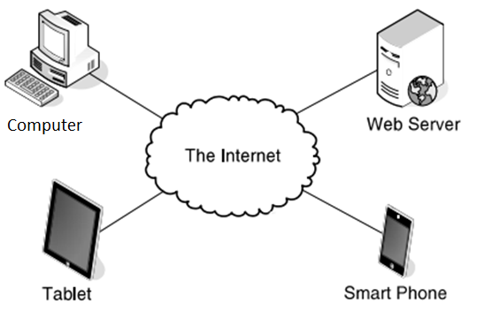
Components of web application

Slide 7
Web Page
Web page is a page content display on web browser
Web page include
Static web page
Dynamic web page

Slide 8
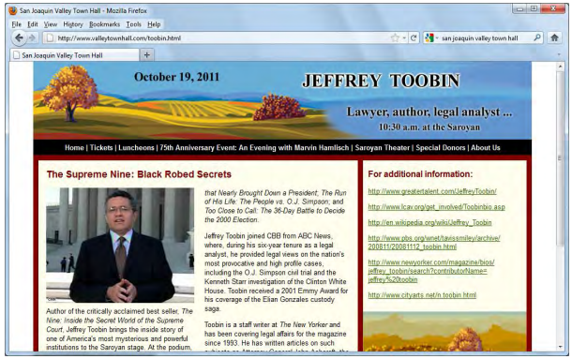
A web page
A static web page

Slide 9
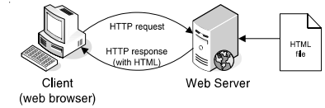
Static web pages are processed

Slide 10
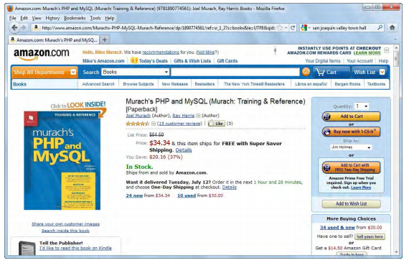
Dynamic web pages are processed
A dynamic web page is a web page that’s generated by a server – side program or script.
A dynamic web page at amazon.com

Slide 11
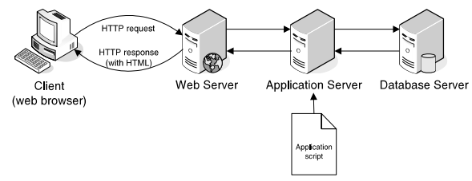
Web server processes a dynamic web page

Slide 12
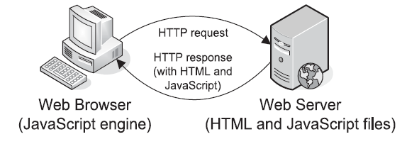
How JavaScript used for client-side processing
How JavaScript fits into web architecture
Three of the many uses of JavaScript
Data validation
Image swap and rollovers
Slide shows

Slide 13
More about JavaScript
JavaScript is a scripting language that is run by the JavaScript engine of a web browser and controls the operation of the browser.
When the browser request an HTML contains JavaScript or link to JavaScript file, both HTML and JavaScript are loaded into the browser.
JavaScript run on client, not in the server so in some case they help the application more efficiently.

Slide 14
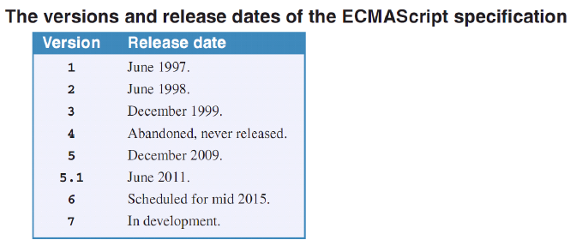
More about JavaScript ..
JavaScript based on the ECMAScript specification which founder by Netscape in 1995 and newest version update on June 2016.
ECMAScript specification details the standards that scripting languages like JavaScript should meet.

Slide 15
The components of
a JavaScript application
Notes:
Session: Ghi số thứ tự session trong môn học
Session Name: ghi tên của session sẽ dạy

Slide 16
The components of a JavaScript applications
The JavaScript application includes:
HTML
CSS
JavaScript

Slide 17
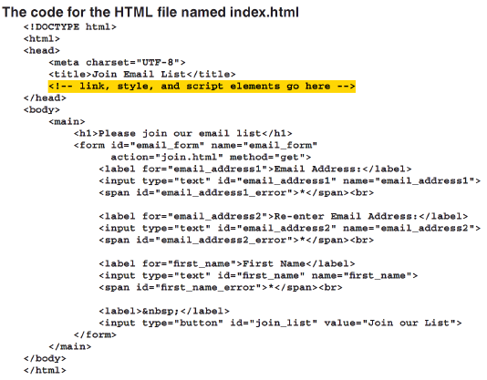
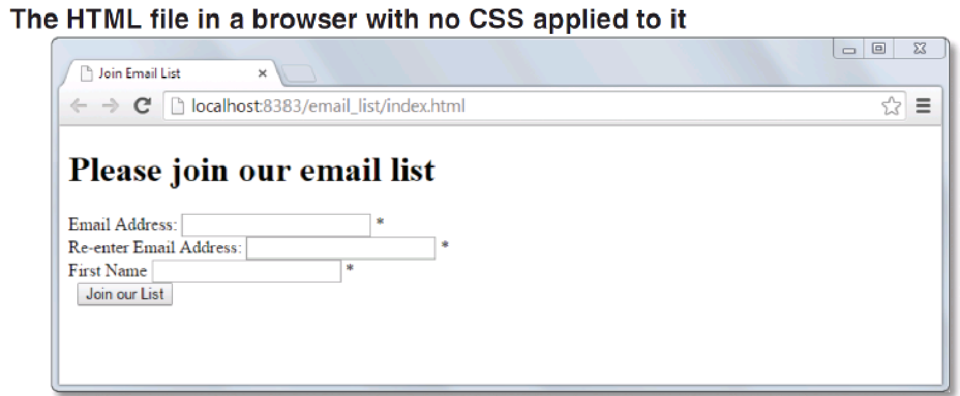
The HTML for email list application

Slide 18
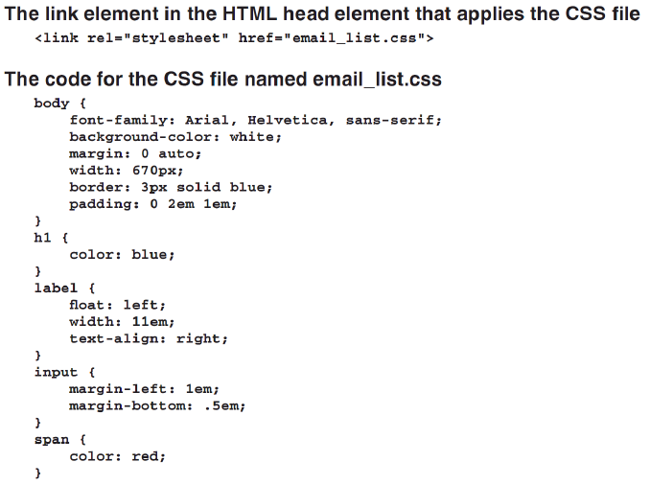
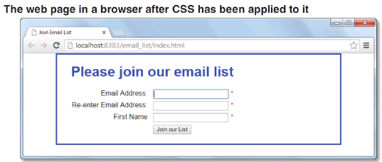
The CSS for email list application

Slide 19
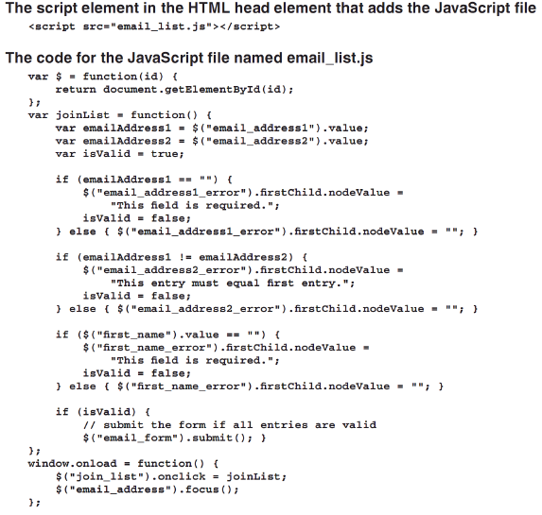
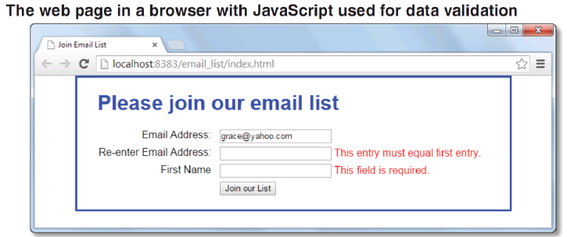
The JavaScript for application

Slide 20
How to test a JavaScript application
Notes:
Session: Ghi số thứ tự session trong môn học
Session Name: ghi tên của session sẽ dạy

Slide 21
How to run a JavaScript application
The JavaScript file is loaded and run when web page is loaded. So run a JavaScript application same with run a web page.

Slide 22
How to find errors in your code
You can used Chrome’s developer tools to find errors in JavaScript code.
Press F12 or Ctrl + Shift + I to open developer tool.

Slide 23
How to develop a JavaScript application
Open new project
Add HTML, CSS file for project
Add JavaScript file and add link to html file
Run and test project result
Notes:
Hướng dẫn học viên chạy được ứng dụng Hello World với JavaScript.

Slide 24
Summary
Web application consist of client, a web server and network.
JavaScript is a scripting language that is run by the JavaScript engine of a web browser.
The ECMAScript specification provides the standards that JavaScript implements.
The JavaScript application includes:
HTML
CSS
JavaScript
Notes:
Tóm tắt lại nội dung đã học

